Slide 1
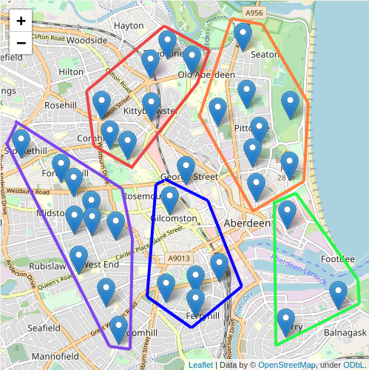
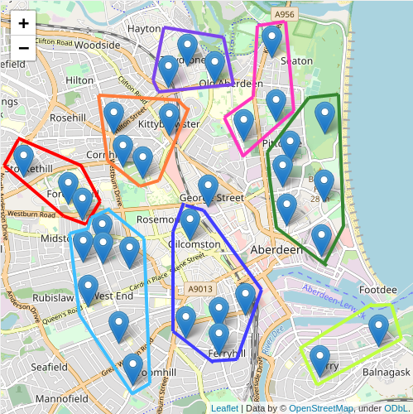
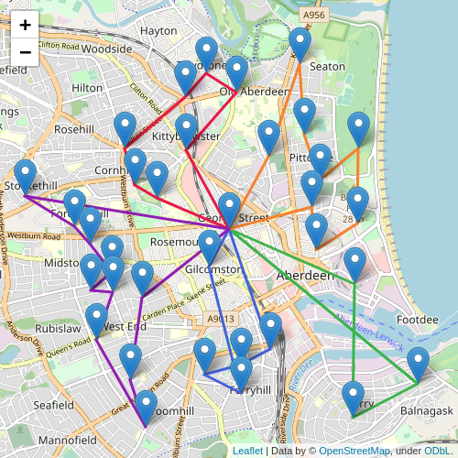
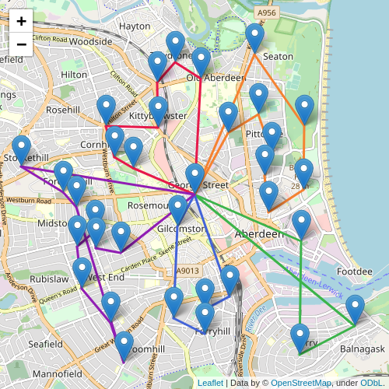
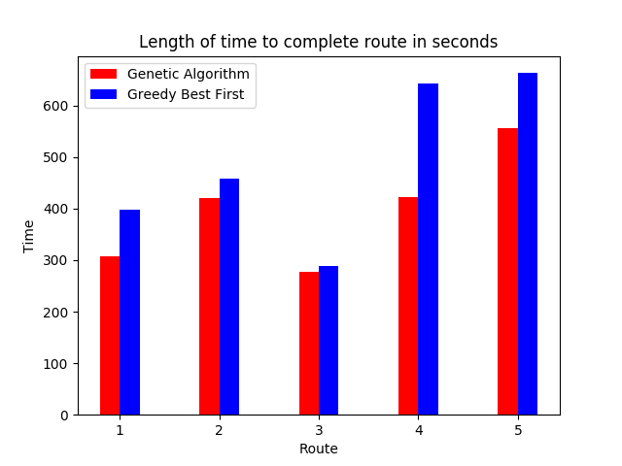
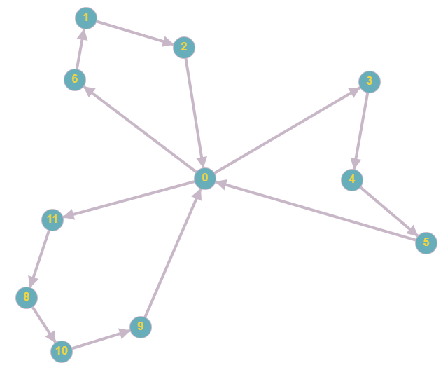
Drone Delivery Scheduling
Clustering and Path Finding to produce a schedule
Andrew Trail & Dr. Kit-ying Hui
Introduction
Testing
Conclusion
Drones are an up-and-coming method of delivering items to customers. They have not been extensively used as of yet, due to being a relatively new technology. There are also some hardware limitations of the drones. These limitations include maximum flight distance, weight capacity, adverse weather conditions, and legal issues (Doring et al.,2017).
However, as drone technology advances they will be able to fly further and carry more weight.
The demand from customers is high, with many being happy to pay extra for same-day delivery (McKinsey & Company, 2016).
This combination of demand from customers and advances in drone technology will lead to an increase in their use. It is safe to imagine a situation in the near future where drones are able to carry multiple items to multiple customers in a single flight.
- The project demonstrates that artificial intelligence can be a useful tool in delivery scheduling. The solution created is able to produce an efficient schedule quickly and easily. It also allows comparison of different path finding algorithms.
- The algorithms are potentially not as optimal as possible, as many factors haven’t been considered due to time limitations of this project. Factors such as the amount of time a customer has been waiting could be considered, so that customers who have waited a long time are given priority in the queue.
- Additionally, the software could be expanded to provide more of a ‘real-time’ environment, showing the current location of drones and sorting new orders into new groups to be completed once drones have completed the route they are on.
- Weight of items is not currently taken into account. In a real system this would be a key consideration, so would need to be added.
- Future work would need to be carried out to implement these features before the system was ready for commercial use.
Figure 2: Customers grouped into 5 clusters by location
Figure 3: Customers grouped into 8 clusters by location
A sample set of data was input for testing purposes. 33 mock customers were added, scattered across Aberdeen. Each marker on the map in Figures 2 and 3 represent a customer.
The clustering algorithm “kMeans” was used to group customers by location. The resulting groups for different numbers of clusters input are shown in Figures 2 and 3.
From this stage, the two path-finding algorithms can be applied to find a route between each customer. If one of the routes is too long to be completed given the input parameters of the drones, the group is split in 2 using “kMeans” again. The process repeats until all groups are given a manageable route, or determined to be impossible.
The path finding algorithms have functions built in to improve the results that are produced. The distance between legs of the route are measured and fed into an algorithm that gives the time required for a drone to complete that leg. This algorithm takes into account the wind speed and direction to produce an accurate result.
Project Aim
The aim of this project is to build a software solution to create an efficient delivery schedule. The schedule should be optimised to reduce the total amount of time taken for each customer to receive their item.
Methods
Figure 1: A set of customers split into groups with routes generated
Figure 6: Comparison of length of routes produced by GA and GBF
Two techniques are deployed to create a schedule:
- Customers are split into groups based on how close they are to one another geographically.
- A path finding algorithm is used to find a route for each drone to follow.
Two path-finding algorithms were implemented to allow comparison of their suitability for the task: Genetic Algorithm (GA) and Greedy Best First (GBF).
Figure 4: Routes for 5 clusters using the Genetic Algorithm
Figure 5: Routes for 5 clusters using Greedy Best First algorithm
References
Evaluation
1 - Dorling, K., Heinrichs, J., Messier, G. and Magierowski, S. (2017). Vehicle Routing Problems for Drone Delivery. IEEE Transactions on Systems, Man, and Cybernetics: Systems, 47(1), pp.70-71.
2 - McKinsey & Company (2016). Parcel delivery. The future of of last mile. [online] pp.9-9. Available at: https://mck.co/34XcEXR
Figure 6 shows that across all routes, GA out-performed GBF. Route 3 shows similar results, with GBF producing a route 3.76% greater than GA. However, in route 4, GBF produced a massively worse route which was 51.89% slower than the route produced by GA.
Interestingly, there are occasions where the Genetic Algorithm produces a longer route by distance, but takes less time to complete. This is because the Genetic Algorithm is able to try many different combinations, allowing it to produce a route where it flies with a tailwind for as long as possible.
BSc. (Hons) Computing
(Application Software
Development

